Slide 1
LSTM Model for Predicting Stock Prices
Frank Davis
Ryan Brock
Quang Le
Rice Fintech
2021

Slide 2

Why LSTM?
Long Short-Term Memory
LSTM model architecture uses gates. These gates allow it to number both recent and long-term sequential data. Which allows us to predict stock price change.
Project Scope: Project Goals and Objectives Using LSTM model to analyze specific groups of stocks to illustrate predicted close price.

Slide 3
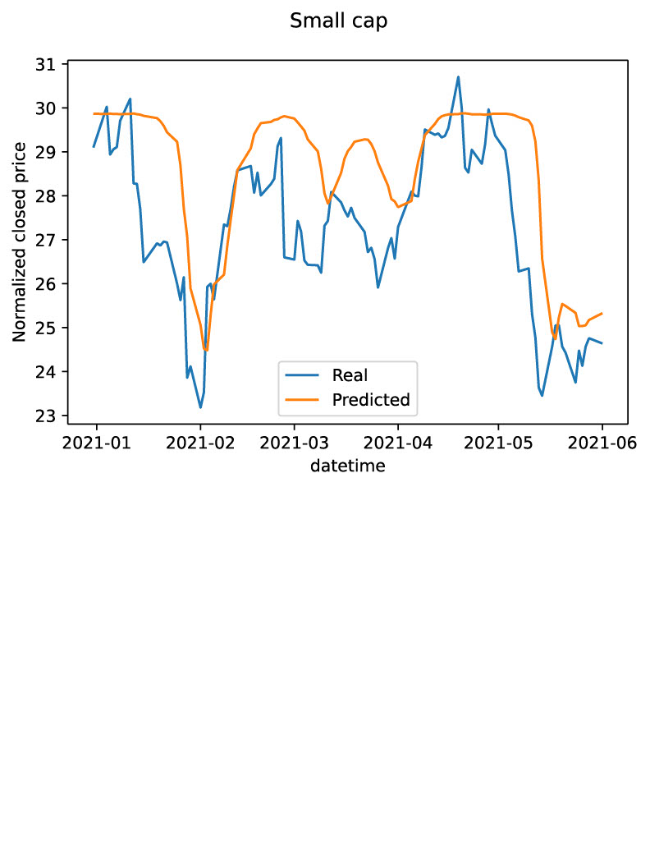
Small Cap Index
The test loss for most of the predictions showed .01
The test loss data was more higher then the training loss which showed the model overfit

Slide 4
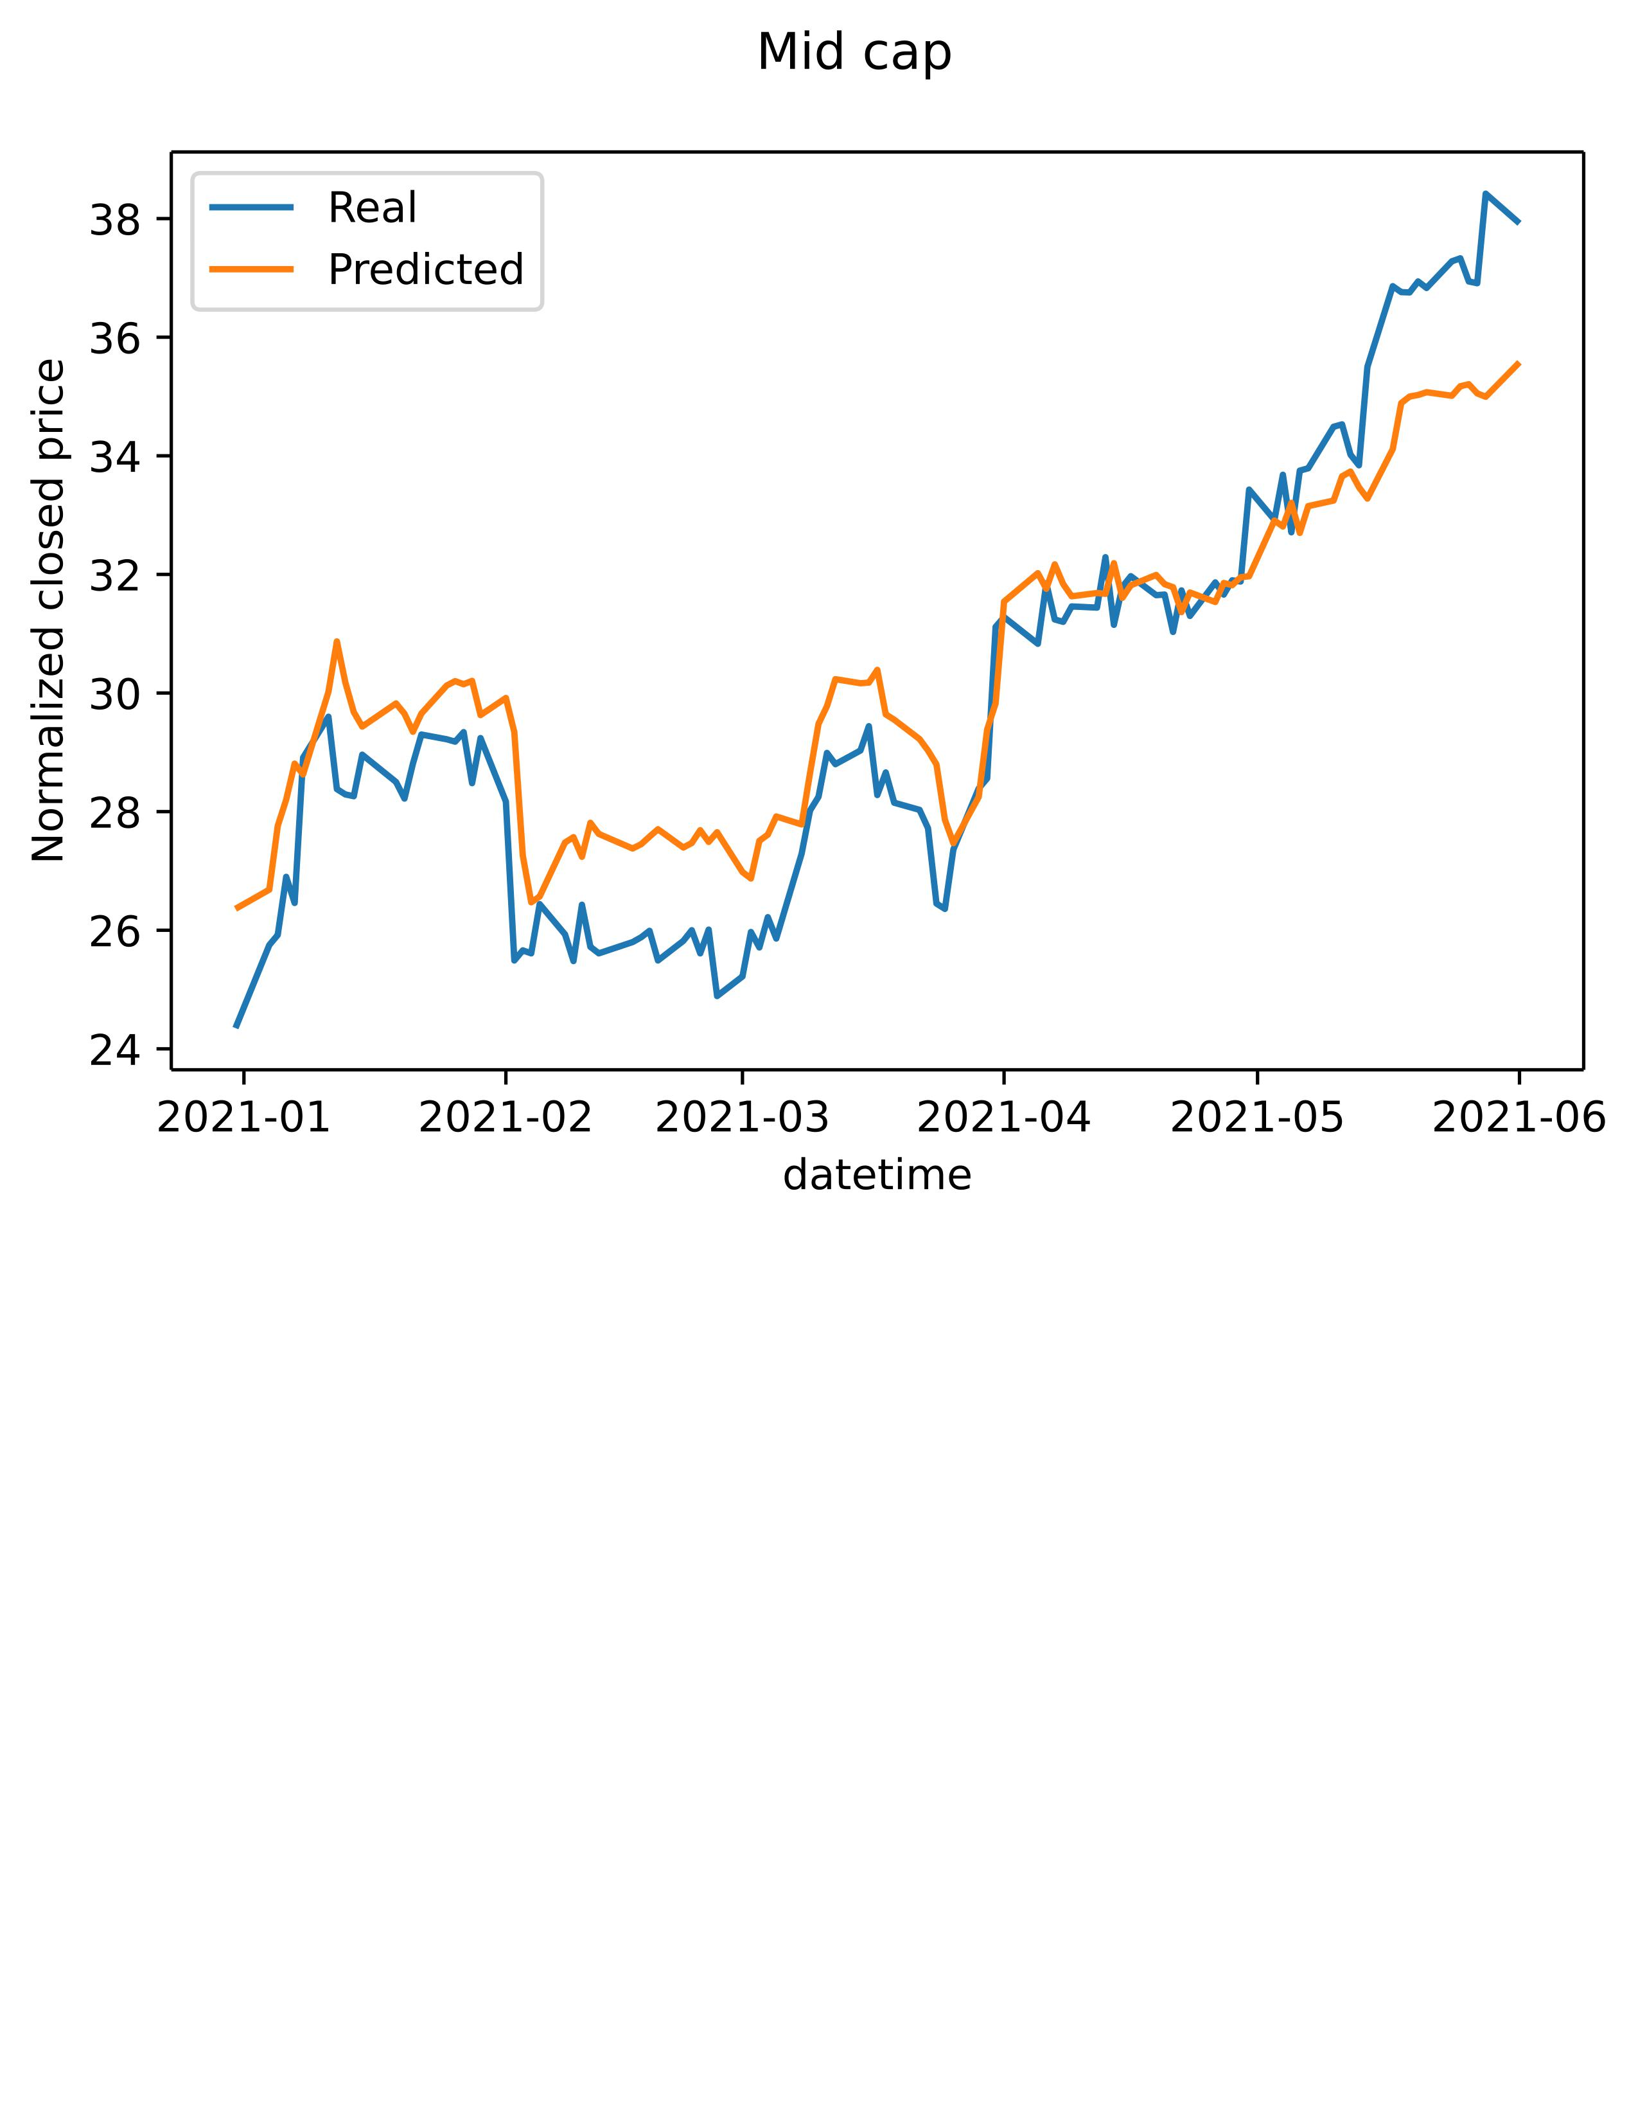
Mid Cap Index
The model seemed to predict mid cap more accurately
visually it seem to be lagging less as well
1
2
3

Slide 5
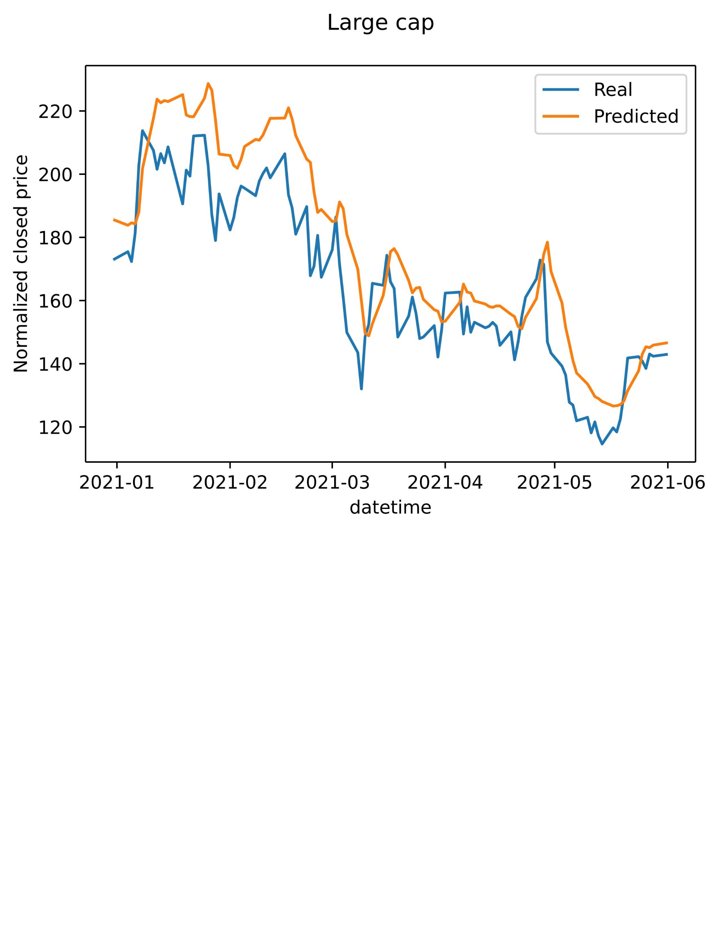
Large Cap Index
Model is not predicting in real time. Prediction is lagging.
Does not have predictive power. Model is learning momentum but not inferring future movement.
Models may need a lot more tweeking and training to become more accurate. (run more epochs)
1
2
3

Slide 6
Conclusion

